Slide 1
Building Social Games for Windows 8 with Windows Azure
Name
Title
Microsoft Corporation

Slide 2
Agenda
Who Will Benefit From This Talk
Developers
Interested in HTML5 Games
Interested in Windows Azure
Interested in Game Development
Topics
Games on Multiple Devices
Architecture of Games
Data
Communication
Handling Scale
Windows 8 Games
What You’ll Leave With
Understanding of Cloud-based Casual Gaming architectures

Slide 3
Context
Building for a Rich Ecosystem
Not locked into a particular device
Best Experience for targeted device
High Resolution for Windows 8
Scaled down for mobile

Slide 4
Features of Connected Games
Authentication
User Settings
State Storage
Real-Time Communication
Game Services: i.e. Leaderboard & Achievements

Slide 5
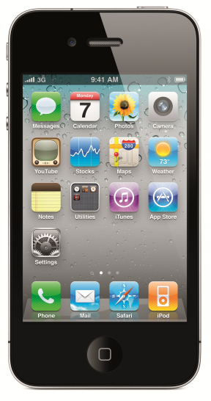
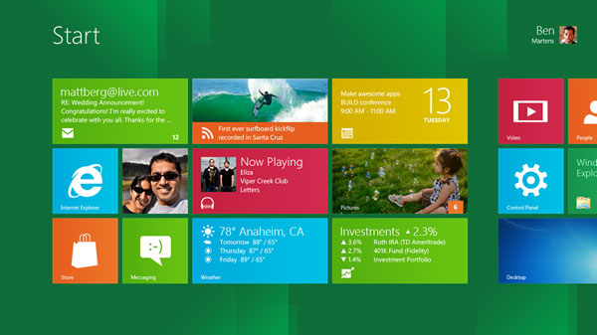
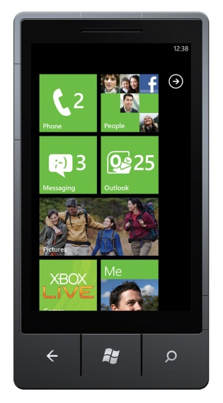
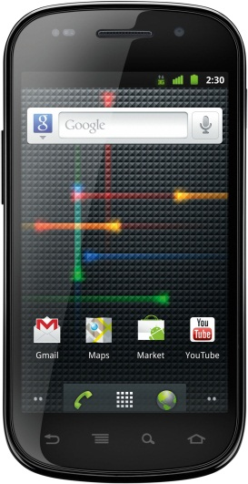





Casual Gaming Ecosystem

Slide 6
Tankster
demo

Slide 7
Architecture

Slide 8
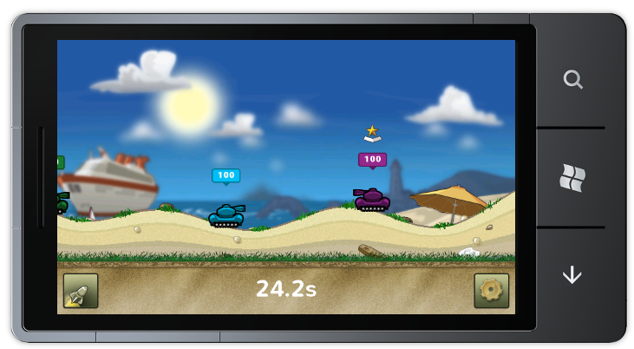
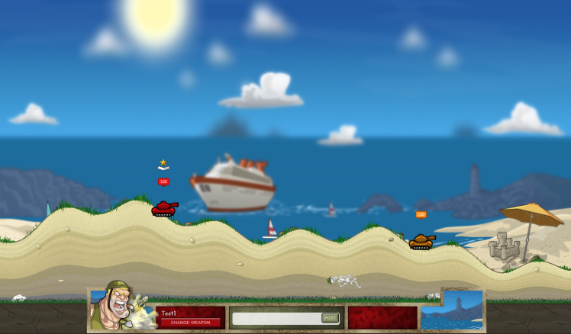
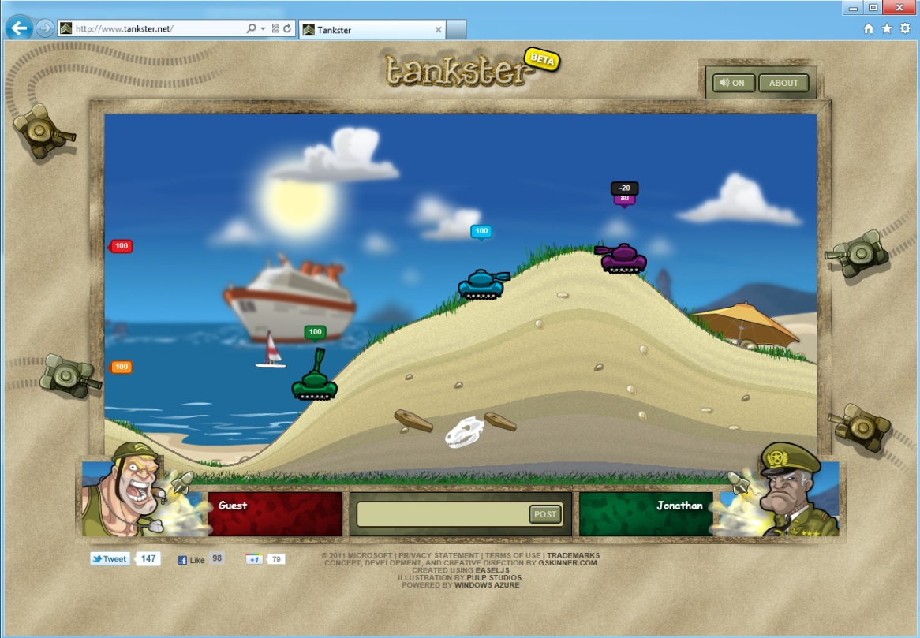
Three Versions of Tankster

Slide 9
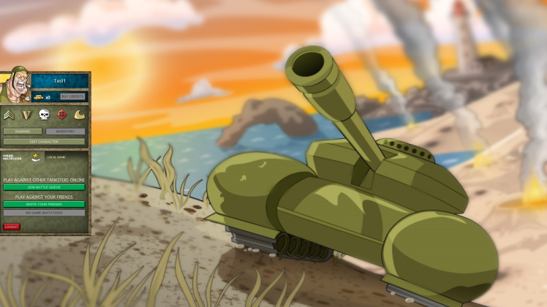
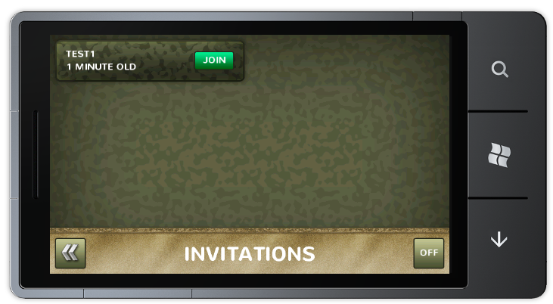

Start A Game
Game Services
Worker
WAZ
Storage

Slide 10
Invite to Play
Game Services
Worker
WAZ
Storage
Notification Services

Slide 11
Accept a Game Invite
Game Services
Worker
WAZ
Storage

Slide 12
Begin Playing a Game
Game Services
Worker
WAZ
Storage

Slide 13
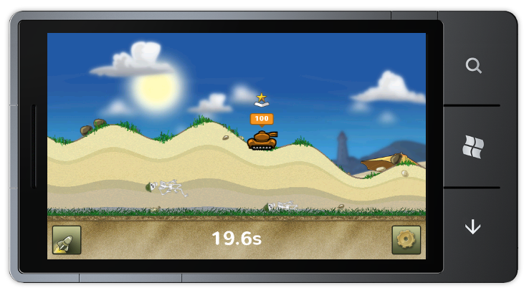
Connect to the Socket Server
Game Services
Worker
WAZ
Storage

Slide 14
Connect to the Socket Server
Game Services
Worker
WAZ
Storage

Slide 15
Patterns
Command – Query Separation
Reliance on Windows Azure Storage
Queues
Blobs
Rest Services
Sockets + Web Sockets

Slide 16
Scale

Slide 17
Decoupled Systems
Many Independent Systems
Scale parts not the entire application
Rely on cloud services

Slide 18
Command – Query Separation
Send a command to the web server
Web server enqueues the command’s message
Worker role reads message from queue and acts on message

Slide 19
Architectural Diagram
Game Services
Worker
WAZ
Storage

Slide 20
JavaScript Start Game
GameService.prototype.startGame = function (queueId, success, error) {
this.serverInterface.sendAjaxPost(this.apiURL + "game/start/" + queueId,
{ gameType: "invitation" }, success, error);
};
ServerInterface.prototype.sendAjaxJsonCommand = function (type, url, data, success, error) {
$.ajax({
type: type,
url: url,
dataType: "json",
data: data,
success: success,
error: (error != null ? error : this.onAjaxPostError)
});
};

Slide 21
Send Game Command
public HttpResponseMessage SendCommand(GameCommand gameCommand)
{
var queueClient = account.CreateCloudQueueClient();
var queue = queueClient.GetQueueReference("gameCommands");
var serializer = new JavaScriptSerializer();
var json = serializer.Serialize(gameCommand);
try
{
queue.AddMessage(new CloudQueueMessage(json));
}
catch
{
return new HttpResponseMessage(HttpStatusCode.InternalServerError,
"error sending game command. try again.");
}
return new HttpResponseMessage(HttpStatusCode.OK, null);
}

Slide 22
Process Game Command
public void ProcessCommands()
{
var queueClient = account.CreateCloudQueueClient();
var queue = queueClient.GetQueueReference("gameCommands");
while (true)
{
var message = queue.GetMessage();
if (message != null)
{
var serializer = new JavaScriptSerializer();
var gameCommand = serializer.Deserialize<GameCommand>(message.AsString);
gameCommandService.DoSomething(gameCommand);
}
}
}

Slide 23
Communication

Slide 24
Two Communication Methods
Push
Pull

Slide 25
Push Communication
Real-Time
Requires More Compute Instances
More Cost Effective for fast paced games

Slide 26
Push Technology
WebSockets
SignalR
Socket.IO
Somewhat limited compatibility on browsers/devices/platforms

Slide 27
Push Communication Architecture
Socket Server

Slide 28
Pull Communication
Slight delay in game commands
Less compute instances
Increased storage costs
More cost effective for slow paced games

Slide 29
Pull Technology
Blob Storage
Http Requests
Compatible on every browser/device/platform

Slide 30
Push Communication Architecture
WAZ
Storage

Slide 31
Push or Pull?
Speed
Scale

Slide 32
Toolkit

Slide 33
What is the Toolkit for Social Games?
Samples
Tools
Guidance
Tic-Tac-Toe
Connect Four
Server APIs
Client Scripts
Test Client
Docs
Architecture

Slide 34
Server APIs
Game Invitations
Leaderboards
Game Friends
User Profile
Game Commands

Slide 35
Generic Server APIs
Web
Mobile
PC
HTML
Windows Phone
iOS
Android
Windows
Mac OS X

Slide 36
Additional Resources
Windows Azure Toolkit for Social Games – watgames.codeplex.com
Nathan Totten’s Blog – ntotten.com

